Slide 1

Sequence diagrams

Slide 2
Static diagrams
Use case and class diagrams are static or structural diagrams.
Helpful to understand the overview of the application, the actors involved, the classes needed and identifying the inheritance and aggregation relationships.
But does not help to represent the lifetime of the object or the interaction of objects with one another.
So, UML also has behavioural or dynamic diagrams that can describe how different objects change.

Slide 3
Sequence diagram
UML Basics: The Sequence diagram
https://www.ibm.com/developerworks/rational/library/3101.html
How to make sequence diagram in Visual Paradigm
https://www.youtube.com/watch?v=18_kVlQMavE

Slide 4
Sequence diagram
Sequence diagram is an interaction diagram that details how operations are carried out
It is a visual way to show the things that happen in a particular interaction between the actor and your system
It shows the order in which events occur like when a particular object activates, invoking methods on objects.

Slide 5
forms of sequence diagram
Sequence diagrams can be used in two forms: the generic form and the instance form.
The instance form describes a specific scenario in detail; it documents one possible interaction. The instance form does not have any conditions, branches, or loops; it shows the interaction for just the chosen scenario.
The generic form describes all possible alternatives in a scenario; therefore branches, conditions, and loops may be included.

Slide 6
Parts of sequence diagram
Participants and Messages are the key parts
Sequence diagram is made up of a collection of participants
Participants interact with each other during the sequence
Participants are usually software objects
Classes/Objects – each class (object) in the interaction is represented by its name on the top
Message – communication between objects

Slide 7
Parts of sequence diagram
Sequence diagram starts with an unattached message arrow
message
unattached
message response
Horizontal axes tells which participant is acting and vertical axes tells time
: Participant 1
: Participant 2

Slide 8
What sequence diagram does?
capture the interaction between objects in a collaboration
Show instances that play the roles defined in a collaboration
Show the order of the interaction by using the vertical axis to represent time when and what messages are sent
Either model generic interactions – showing all possible paths
OR specific instances of the interaction – showing just one path
through the interaction

Slide 9
Representing objects
Box with the underlined label specifies the object
Dashed vertical lines represents the life span of the object
Anonymous object
Object_name : class_name
Named
Named object
Rob : Person
Rob
: Person
Object of unknown class
lifeline

Slide 10
Representing messages
Method call: horizontal arrow to the receiving object. Write message name and arguments above the arrow
Arrow types tell type of the message
Synchronous message : solid arrow with solid head
Asynchronous message : solid arrow with stick head
Return message : dashed arrow with stick head
open(accountID, balance)
: BankAccount

Slide 11
Method execution
Activation: When the object is in memory (stack), it means object is either running the method’s code or its waiting for another object’s method to finish. This is shown using thick box over object’s lifeline
Nest activation: object calls itself
: BankAccount

Slide 12
Object’s lifetime
An arrow with new header on it shows object creation i.e. beginning of object’s lifetime
X at the bottom of the object’s lifeline tells that object is deleted and has been removed from memory by garbage collector
new
changeDate
printDate
: BankAccount
: Date

Slide 13
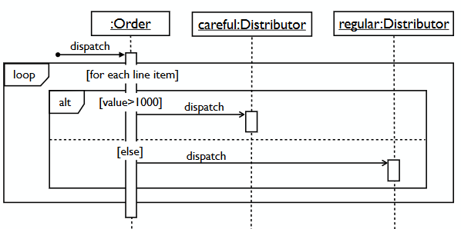
Loops and alternatives
A box around part of the sequence diagram shows a frame
if → (opt) [condition]
if / else → (alt) [condition], separated by dashed line
loop → (loop) [condition or item to loop over]

Slide 14
Sequence diagram for withdraw cash
withdraw() insert card
request password
type password
verifyDetails()
account ok
inputAmount() new
update commit
release cash print receipt, eject card
:Customer
:ATM
:Bank
:Transaction

Slide 15
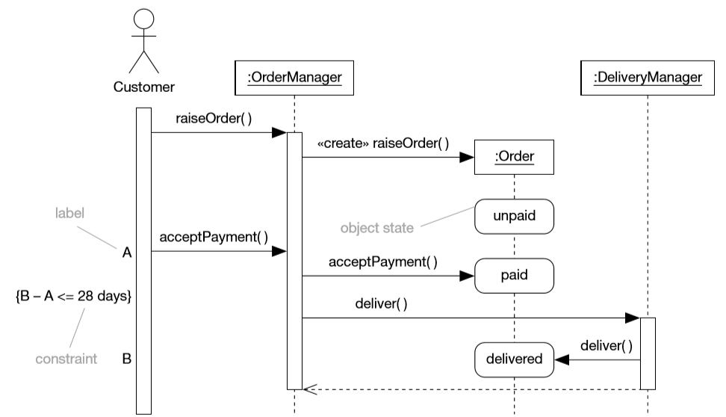
Sequence Diagram for placing order

Slide 16
Why to make sequence diagram?
Useful for sketching out a situation that’s not completely clear.
Sequence diagrams are not language specific. Once made, can be implemented in many different languages
Can be done easily as a team
Non – programmers can read and write sequence diagrams
Close to actual code
Provides the wide scenario of a module as many objects/classes can be seen at a time on a page

